Slide 1
Holland Career Lesson
11th Grade Students
Session One
Directions:
Log onto windows.
Go to connection.naviance.com/pikesvillehi
Log onto your Naviance account. *Your user name should be the same from last month, which should be your email address*

Slide 2

How do we pick careers?

Slide 3
When Steve was 10 years old, he wanted to be a doctor.

Slide 4
Then, during a neighborhood accident, he witnessed a compound fracture.

Slide 5

Steve immediately suffered an attack of nausea that forced him to leave the scene

Slide 6
Thinking about it later, Steve arrived at a truth: he could never become a physician…If a patient has a broken bone, he would vomit all over the them.

Slide 7

Career and Personality Assessments
Myers Briggs Personality Assessment
Holland Code Career Assessment
The Big Five
Career Cluster Test

Slide 8
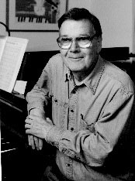

Holland Codes - RIASEC
the choice of a vocation is an expression of personality

Slide 9
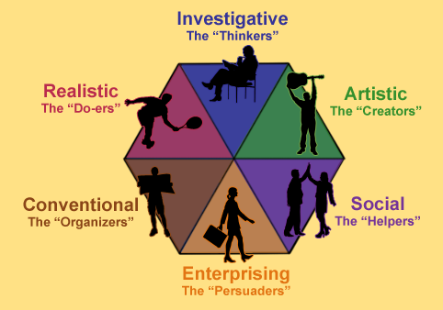
RIASEC Code Theory
individuals can be categorized in six different types.
work environments can be categorized in six different types.
individuals tend to choose environments that fit with their personality.
highlights the importance of one’s personality being congruent with his or her environment.

Slide 10
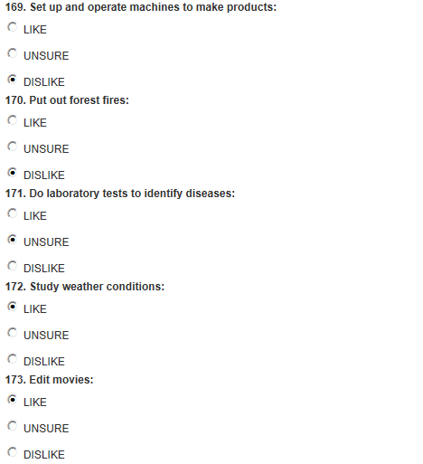

Slide 11
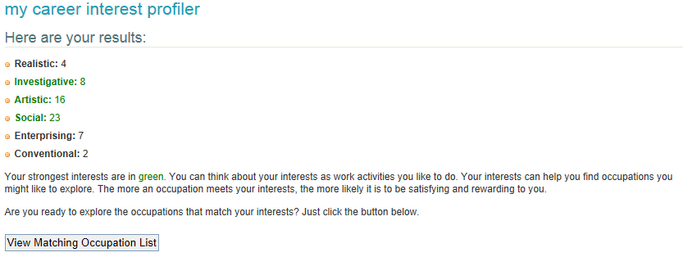
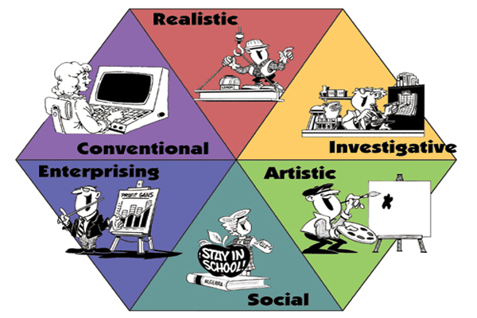

Slide 12
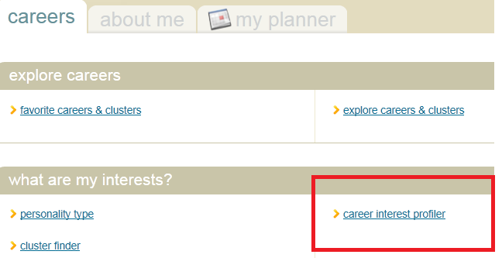
1. Click on the Careers Tab and Begin the Career Interest Profiler.
2. Use your results, and explore Naviance, to complete the worksheet.

Slide 13
Holland Career Lesson
Objective: SWBAT relate personal abilities, skills, interests and motivations to career choices by discussing five careers, in a group setting, in order to understand that multiple careers can produce job satisfaction.
11th Grade Students
Session Two
If you took your results worksheet home, from the Career Interest Profiler, please get them out now.
If your results worksheet was collected, please wait for it to
be passed back to you.

Slide 14
Just to Review…..

Slide 15

Warm Up Questions : Answer on the back of your worksheet
.
What is a benefit of taking the career interest profiler?
Why may it be recommended to find a career in your primary or secondary Holland Career type?

Slide 16
Corners Activity
How do you feel about the results of your John Holland Career assessment. Did it reflect who you think you are? Did it surprise you? Do you disagree?
When directed, move to the corner of the room that matches how you feel about your John Holland Results.

Slide 17
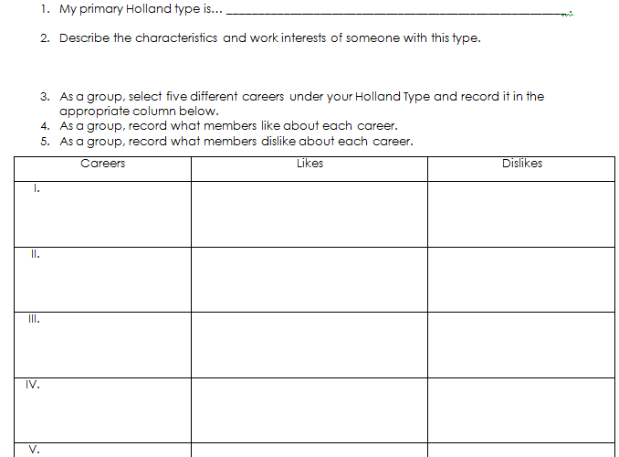
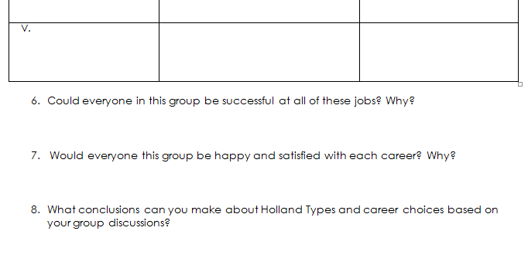
Group Activity
Move into your Primary Holland Type Group (Social, Realistic, Conventional, Artistic, Investigative, or Enterprising)
As a group, complete the front of today’s worksheet. Your group will be presenting your information at the end of today’s classtime.

Slide 18
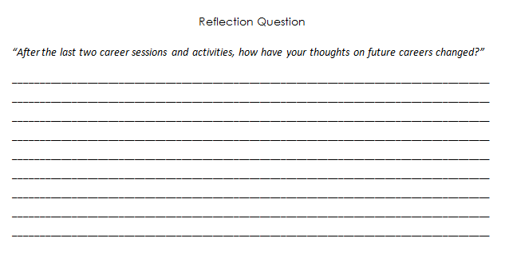
Individual Reflection
As your exit ticket complete the reflection on the back of your worksheet.

