Slide 1
ASCA Mindsets & Behaviors for Student Success
K-12 College and Career Readiness Standards for Every Student

Slide 2
ASCA National Standards
for Students

Slide 3
ASCA National Standards
for Students

Slide 4
ASCA Mindsets & Behaviors
for Student Success
ASCA National Standards
for Students

Slide 5
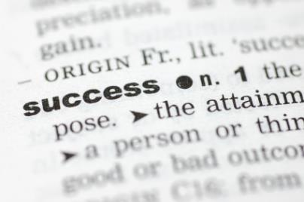
How do we define
student success?

Slide 6
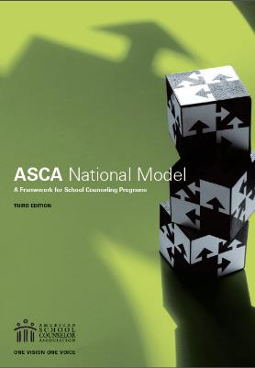
Outcomes
Academics
Behavior
Attendance

Slide 7
Standards
Knowledge
Attitudes
Skills

Slide 9
Revision Process 2012-14
CCR Committee Forms

Slide 10
Revision Process 2012-14
CCR Committee Forms
Review Research & CCR Documents

Slide 11
Revision Process 2012-14
CCR Committee Forms
Crosswalk, Organize & Refine
Review Research & CCR Documents

Slide 12
Revision Process 2012-14
CCR Committee Forms
Crosswalk, Organize & Refine
Review Research & CCR Documents
Public Comment & Finalize

Slide 13
CCR Committee

Slide 14
Key Research

Slide 17
College & Career
Readiness

Slide 20
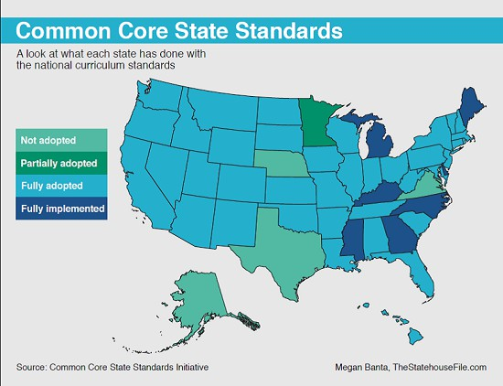

Slide 22
Mindsets & Behavior Standards

Slide 23
Domains

Slide 24
Domains
Academic
Career
Social/Emotional

Slide 25
Categories of Standards
Mindsets
Behaviors

Slide 26
Mindset Standards
Includes standards related to
the psycho-social attitudes or beliefs
one has about oneself
in relation to academic work.
These make up the
students’ belief system
as exhibited in behaviors.

Slide 27
Behavior Standards
These standards include
behaviors commonly associated
with being a successful student.
Learning Strategies
Self-Management Skills
Social Skills

Slide 29
Competencies
Specific, measureable expectations
that students attain
as they make progress
towards the standards.

Slide 30
Grade Levels
K-2
3-5
6-8
9-12

Slide 31
Bridge to Curriculum Standards

Slide 32
ASCA
Mindsets &
Behaviors
Common
Core

Slide 33
Competencies
ASCA
Mindsets &
Behaviors
Common
Core

Slide 34
Competencies
ASCA
Mindsets &
Behaviors
State
Standards

Slide 35
Alignment with Common Core
Common Core
Grade 2 Speaking and Listening
Tell a story or recount an experience with appropriate facts and relevant, descriptive details speaking audibly in coherent sentences

Slide 36
Alignment with Common Core
Common Core
Grade 2 Speaking and Listening
ASCA Mindsets & Behaviors
K-2 Social/Emotional
Tell a story or recount an experience with appropriate facts and relevant, descriptive details speaking audibly in coherent sentences
Write or tell a story or recount an experience with appropriate facts and relevant, descriptive details in coherent sentences about how it feels to be successful

Slide 37
Academic, Career & Social/Emotional
Write or tell a story or recount an experience with appropriate facts and relevant, descriptive details in coherent sentences about…
…what academic success looks like. | Academic
…what career success looks like. | Career
…how it feels to be successful. | Social/Emotional

Slide 38
Where Do Competencies Come From?

Slide 39
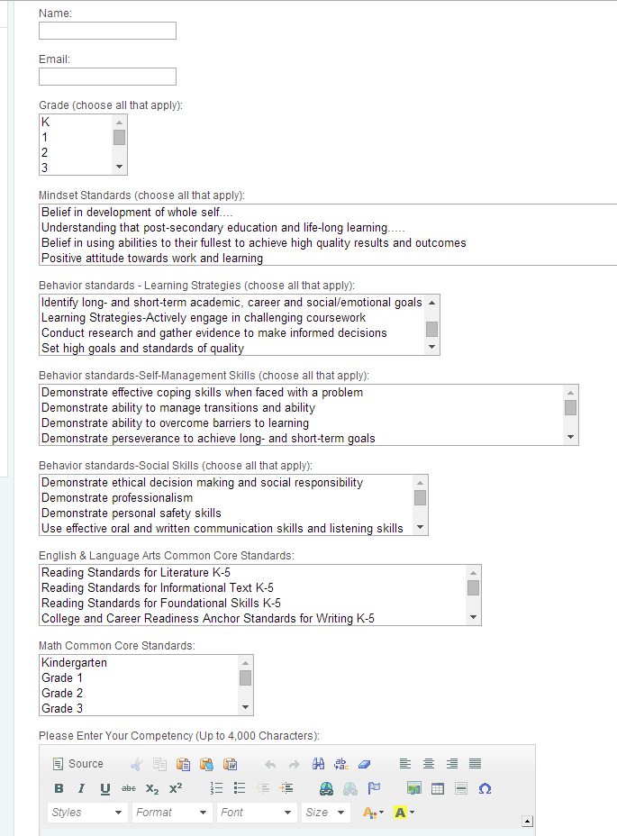
Where do Competencies Come From?
ASCA
States
Practitioners

Slide 40
Key Connections
Data
Academic standards

Slide 41
Mindsets & Behavior Standards

Slide 42
Competencies

Slide 43
Getting Started: ASCA Mindsets & Behaviors

Slide 44
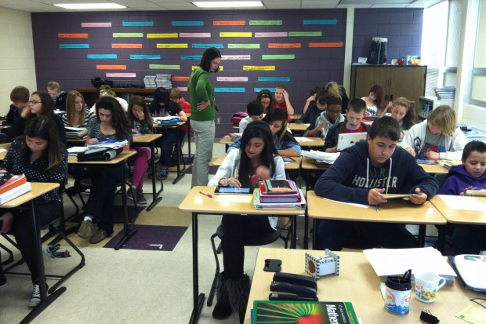

Slide 45
Step 1 - Classroom Lessons
How do you know
where to start?

Slide 46
Step 1 - Classroom Lessons

Slide 47
Mrs. Robinson’s Class – Not Achieving at Potential
Academic
Attendance
Behavior

Slide 48
Mrs. Robinson’s Class – Not Achieving at Potential
Academic
Attendance
Behavior

Slide 49
Step 2 Classroom
Identify mindset and behavior standards that relate to student academic needs

Slide 51
Step 2

Slide 52
Step 2
Academic needs

Slide 53
Step 2
Academic needs

Slide 54
Step 2
Academic needs

Slide 55
Step 2
Academic needs

Slide 56
Step 3
Consult M&B
database
schoolcounselor.org/studentcompetencies

Slide 57
Step 3
Consult M&B
database
schoolcounselor.org/studentcompetencies

Slide 58
Step 3
Consult M&B
database
schoolcounselor.org/studentcompetencies

Slide 61
Step 4 – Design Lesson
Competency
Potential Materials
Integrate multiple sources of information presented in diverse formats and media (e.g., visually, quantitatively, orally) about the importance of engaging in challenging coursework
in order to make informed decisions and solve problems, evaluating the credibility and accuracy of each source and noting any discrepancies among the data.
Video
Speaker
Transcript
College admissions website

Slide 62
Step 4 – Design Lesson
Competency Breakdown
Potential Activities
Integrate multiple sources of information presented in diverse formats and media (e.g., visually, quantitatively, orally) about the importance of engaging in challenging coursework
in order to make informed decisions and solve problems,
evaluating the credibility and accuracy of each source and noting any discrepancies among the data.
HS course plan
College search plan

Slide 63
Step 4 – Design Lesson
Competency Breakdown
Potential Activities
Integrate multiple sources of information presented in diverse formats and media (e.g., visually, quantitatively, orally) about the importance of engaging in challenging coursework in order to make informed decisions and solve problems,
evaluating the credibility and accuracy of each source and noting any discrepancies among the data.
Evaluate the message from video/speaker
Evaluate transcript
Compare transcript to admissions requirements

Slide 64
Step 5 Classroom
Deliver activity or intervention

Slide 65
Step 6 Classroom
Evaluate
Process
Outcome
Perception

Slide 67
SC Curriculum Action Plan

Slide 68
RAMP
Application | Standards
Oct 2015 | ASCA Student Standards Or ASCA Mindsets & Behaviors
Oct 2016 | ASCA Mindsets & Behaviors

Slide 69
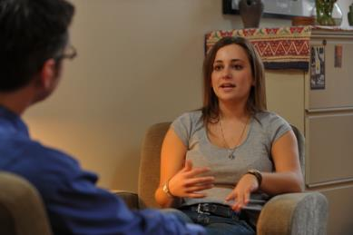
Individual & Group Counseling

Slide 70
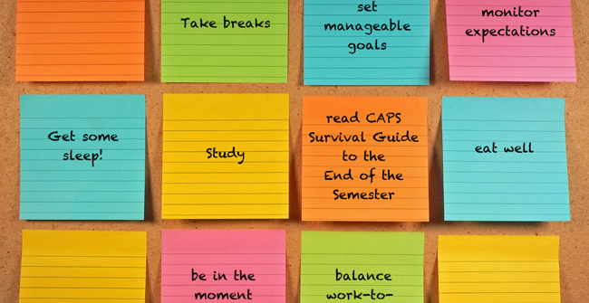
Step 1 Jordyn & Quinn Ind & Group
Issue/Focus

Slide 71
Step 2 Ind & Group
Identify mindset and behavior standards that relate to student social/emotional needs

Slide 72
Step 2
Social/Emotional Needs

Slide 73
Step 2
Social/Emotional Needs

Slide 74
Step 2
Social/Emotional Needs

Slide 75
Step 2
Social/Emotional Needs

Slide 76
Step 2
Social/Emotional Needs

Slide 77
Step 3
Consult M&B
database
schoolcounselor.org/studentcompetencies

Slide 78
Step 3
Consult M&B
database
schoolcounselor.org/studentcompetencies

Slide 79
Step 4 – Ind/Group Focus
Competency
Potential Materials
Integrate multiple sources of information presented in diverse formats and media (e.g., visually, quantitatively, orally) about a conflict or disagreement
in order to make informed decisions and solve problems, evaluating the credibility and accuracy of each source and noting any discrepancies among the data.
Tell the story
Character traits
School policy

Slide 80
Step 4 – Ind/Group Focus
Competency Breakdown
Potential Activities
Integrate multiple sources of information presented in diverse formats and media (e.g., visually, quantitatively, orally) about a conflict or disagreement
in order to make informed decisions and solve problems,
evaluating the credibility and accuracy of each source and noting any discrepancies among the data.
Discuss conflict resolution tips
Bullying prevention/intervention

Slide 81
Step 4 – Ind/Group Focus
Competency Breakdown
Potential Activities
Integrate multiple sources of information presented in diverse formats and media (e.g., visually, quantitatively, orally) about a conflict or disagreement in order to make informed decisions and solve problems,
evaluating the credibility and accuracy of each source and noting any discrepancies among the data.
Discuss each side of the situation
Evaluate how appropriate individual actions were

Slide 82
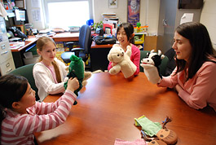
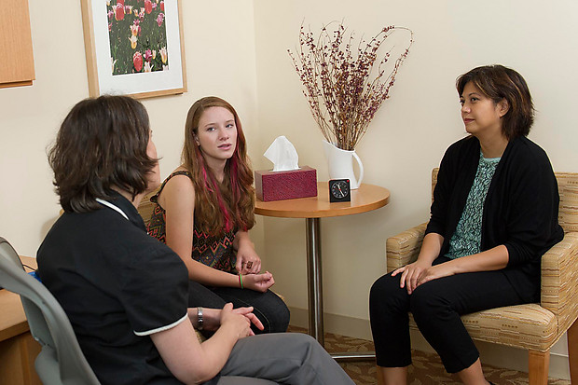
Step 5 Ind & Group
Follow up

Slide 83
Step 6 Ind & Group
Evaluate
Process
Outcomes
Perception

Slide 84
Write a Competency
Grade
Domain
Mindset/Behaviors
CC – ELA/Math
Competency Language

Slide 85
Next Steps
Add new competencies
Implementation
Research on Effectiveness

Slide 86
And…Celebrate Student Success!

Slide 87
ASCA Mindsets & Behaviors for Student Success
K-12 College and Career Readiness Standards for Every Student
Eric Sparks, Ed.D.
Esparks@schoolcounselor.org

