Slide 1
What Do YOU Want to be When You Grow Up?

Slide 2
What is a Career?
A career is job or a profession that someone does for a long period of their life.

Slide 3
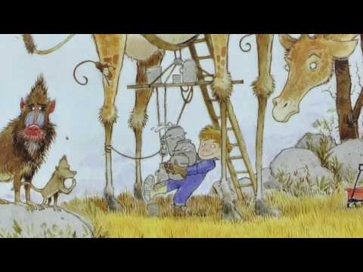
Watch VIdeo
Discussion Questions:
What does the boy in the book want to be when he grows up? (Many things!)
Who did he look up to? (Grandfather & his teacher) Why?
How do you figure out what career you will go into? (Look at your skills and interests.)
Why do you think it’s important to start thinking about our careers while you are young? (So you can become stronger in areas like school subjects and other skill sets.)
When I Grow Up
by “Weird Al” Yankovic

Slide 4
Secret Message
Use the code to decipher the secret message.

Slide 5
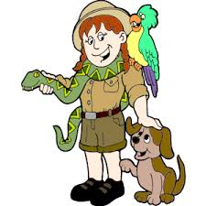
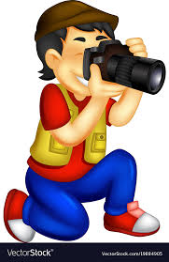
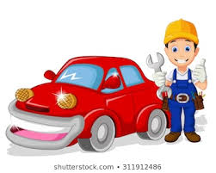
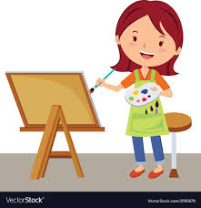
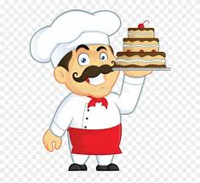
A
B
D
G
E
H
I
N
T
O
R
U
Y
W

Slide 11
?

Slide 12
What DO YOu Want to Be?

Slide 13
Draw A picture Of your Future Career
Take a picture and send it to Dr. Jones at
laura.v.jones@fcps.org

