Slide 1
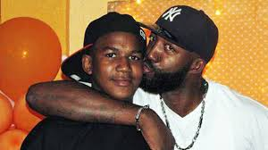
Dealing with Grief and Loss
Lynne E. Muller, PhD., NCC, LCPC-S
The Breakthrough Center, Maryland State Department of Education
lynne.muller@maryland.gov
410-767-3364
Notes:
Some of the most draining and difficult work we do but for your kids, it is some of the most necessary
Much of the work we do..
Every one of your kids has already experienced multiple losses so they are often hyper-sensitized for emotions and thoughts about loss.

Slide 2
Grief and Incarceration
Experiencing multiple severe losses can be a strong factor leading to incarceration.
Our prison system, instead of addressing loss, increases the number of losses, depression, and grief issues.
By addressing people's needs following a loss instead of punishing the symptoms, incarceration and recidivism can be reduced
Group works best (research with men and separately with women in prisons)
Notes:
For inmates grief is often cumulative. In grief counseling within the correctional setting, it is not uncommon to work with persons who have had multiple losses.
One young woman in her early 20s described how one brother died when hit by a car, another was shot, and her daughter died from SIDS (Sudden Infant Death Syndrome). While she was incarcerated, another child in her family was murdered
They are removed from their families and loved ones. If a loved one is ill, they are not able to participate in his or her care and guilt feelings compound their grief. This is also true when there is unexpected dying and death.
Many people hold the belief that the death would not have occurred if they were out and could have protected the person they love
Showing vulnerability is not part of prison culture
No access to a close and permanent replacement person.

Slide 3
Deaths alter our lives and require a period of adjustment
Notes:
What does this mean to you?

Slide 4
Grief is a process, not an event
Notes:
It takes time and has its own time table

Slide 5
Lots of Losses
What kinds of losses have your students already experienced?
Notes:
death, absence, change, social

Slide 6
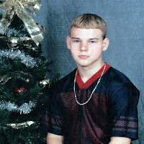
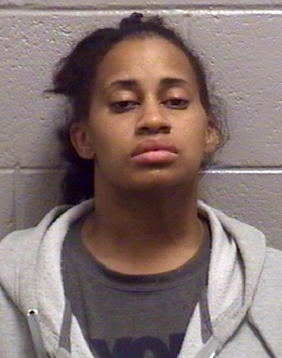
Adolescence
All about loss
Separation anxiety
Depression
Introspection
Self-understanding
Notes:
What about adolescence makes this so much more complicated?
Teens are in the developmental stage of separation-which involves a lot of losses
They are mourning the loss of their childhood and the permission it gave them
Many mourn the loss of their relationship with their parents who try to “control” them
They lose their security-they know they are vulnerable and are aware that parents can’t always protect them
And they feel anxious-what will they be/ who will they be? And they search for someone to latch on to. And that often results in a loss of self wether it is a girl or boyfriend, a dealer, a player, a fighter, a gang it is someone to plug the hole.
They often feel abandoned-and many of your kids have actually been abandoned more than once-left by a “parent” placed in a foster home, removed, placed again….
And we know that depression can look like anger.

Slide 7
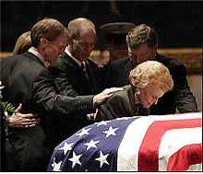
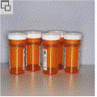
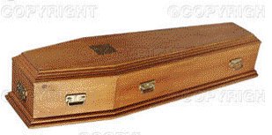
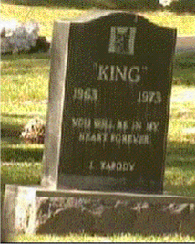
Our Culture
Media
Funeral
Industry
Quick Fix
Corporate America
Death of pets
Notes:
Our culture manages death differently than many other cultures.
Quick Fix – We do want our food fast. We want our information fast. If something hurts, we want to take a pill and feel better. The days of wearing black clothing for a year are gone.
Media Blitz – moment by moment coverage that is dramatic, focused on the significance of loss
Presidents
Princess Diana
shootings
Funeral Industry –
We spend a lot of money.
We are somewhat removed from the reality of death by the extraordinary efforts to “make the person look good”.
Wailing is acceptable in other cultures. In our culture people try not to cry.
Corporate America –
Expectation that you miss three days and then return to full duties
Death of pets – quite different in other cultures

Slide 8
Our Children
Society uses euphemisms
Families “protect” children
Schools expect a return to routines
Friends don’t ask
Adults don’t ask
They feel alone
Notes:
Society uses euphemisms – passed away, passed on, lost, laid to rest – many people are not comfortable saying the word “death” – Pretend deaths on TV, movies, and video games may contribute to our distance from the reality. Of course, we have to acknowledge that in some of our communities, violent death is common.
Families “protect” children – We don’t want our children to be unhappy so we may exclude them from the funeral experience, try not to cry in front of them. Some adults allow themselves to believe that young people do not grieve as intensely.
This false belief is somewhat perpetuated by the fact that many young people have a delayed reaction, so through the funeral process and during the early weeks, it seems as though they are doing OK. IN one book I read, it suggested referring to this as hibernation. Their minds kind of go numb until they can begin to allow themselves to think about the reality.
Schools expect them to return to routine (as with work places)
Friends don’t ask – They don’t know what to say. They don’t want to upset them. Talking about it makes death more real, which is scary.

Slide 9
Our Children
“No one talked to me about it . . . at all. I felt kind of like an outsider at school because no one said anything about it.”

Slide 10
Ourselves
Personal Loss
Relationship
Lack of personal experience with loss
Notes:
Being the caretaker in a school can be complicated by a number of factors.
Personal loss – if we have experienced the loss of someone important to us in our personal life, especially if it was recent.
Relationship with deceased or the grieving person – If we have a particularly close relationship with the staff member or student who is grieving.
Not having experienced a close loss oneself – We may feel inadequate to understand.

Slide 11
Words…
Grief
Mourning.
Notes:
Grief-internal responses (personal thoughts and feelilngs abouttheloss) followig a berevement which may lead to maladaptive bheaviors
Mourning-a shared social response to al loss, sharing ones’ grief with others, accomplishing the tasks of living with the loss.

Slide 12
Consider Your Own Experience
All of us have had to deal with losses.
Where we are in the process affects how we react and interact with others.
Every loss touches every other loss.
Notes:
Worksheet. Share and discuss
Our understanding of death and our coping skills to deal with grief, evolved through the life cycle. Consider these questions and share with someone near you.
It is important to explore our own history with grief issues because:
We may have our own questions about existential issues.
We may feel anxious about our own expertise with grief and loss.
We may feel fear regarding the safety of our own family members.
If we have personal unresolved grief, we may have difficulty staying focused on the needs of the student. We may feel the need to “rescue”.

Slide 13
Secondary Losses
Not only did I lose you I also lost……
A friend….
Notes:
Card and markers
The roles the deceased played in your life
Hold up a card with a word on it…
Changes in the environment (moves, loss of status (not married anymore, alternations in relationships with family)
no longer connected to grand parents with death of parent, former spouse’s family

Slide 14
GRIEF
Natural reactions when we experience the loss of a love one
Grief expresses three things
Your feelings about the loss
Your protest at the loss (wish to undo it, and desire to deny it)
The effects from the emotions, thoughts and behaviors resulting from the loss
Notes:
Effects-the emotions you feel –crying. Flattening of affect, numbness
Cognitions-thoughts we tell ourselves to try to understand the loss
Behavioral reactions-not eating ,not sleeping, eating or sleeping too much….

Slide 15
The Truth about Grief
Grief is an active process
Grief work is intense emotional work
Grief takes time
Grief is experienced differently
Grief causes complications
with normal coping
Notes:
There are thoughts and feelings that one must work through in order to resolve grief. It is an active process.
We pay a heavy price for how our culture manages grief. Because of the unrealistic expectations of the people around us, many people do not understand the intensity of the emotional pain.
Many people report that the second year is more difficult. Young people, in particular, often have a delayed reaction.
Some people need to be active until they are more ready to deal with the loss in small doses.
Some people need to be quiet and think.
Some people need to talk about it a lot.
Some people need to do something like write poems, draw pictures, create a scrapbook.

Slide 16
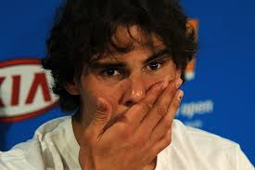
Grief-The emotional experience
Shock
Panic
Guilt
Hostility
Depression
Notes:
Caught in a maze, unable to see a way out
Climbing out of a pit of despair
Shock and numbness at first, can’t believe it.
When that wears off there is rise to many emotions some of which can cause physical distress-neglect of our own needs or overindulgence to numb the pain
Panic-future uncertain, too much unknown
Guilt-people tend to fault or blame themselves but seldom do our teens talk about that. Especially in suicide they look for a reason beyond the depression. adolescents are narcissistic anyway –think they are powerful enough to have prevented it
anger-not fair, why/ why him? Why me? Why now? Why like this?
We hate not having answers
Depression. A kind of drifting, feeling little, hard to get back to normal
And eventually some hope.

Slide 17
The physical experience
Appetite change
Slow reflexes
Always tired
Forgetfulness
Headache
Pain
Nausea
Racing heart
Weakness
Muscle tension

Slide 18
The reactions
Numbness
Yearning
Disorganization
Reorganization
Notes:
Numbness
Emotional shock, disbelief, denial, feeling empty
Yearning
Feeling the presence of the deceased
searching, hoping for them to return
Sometimes restlessness, agitation, insomnia, nightmares, uncontrollable crying, feelings of panic
Disorganization, despair
Disorganization
The reality of the loss
Feeling hopeless, powerless, sad, angry, guilty
May lose interest in school, activities
May sleep a lot, lack energy
Reorganization
Feeling overwhelmed by the loss less often and less intensely
Gaining perspective
Emotionally relocating the deceased
Working through the thoughts and feelings
Developing a plan for moving on
Adjusting to the environment without the deceased
Feeling hope
Drawing strength from the loss

Slide 19
Males vs Females
Guys don't do grief, guys get mad.“
Society messages
Vulnerability and weakness
Girls talk and process the loss by sharing it
Privacy
Support Systems
Notes:
Men say that they limit their expression of emotion because they may not want to appear weak.
Men are often faced with the duty of being strong and so may be given little social support. Society has traditionally taught little boys not to cry while on the other hand comforts little girls who do.
Men tend to be more comfortable attending to life changes by taking on new roles and responsibilities that result from the death of a loved one
So often they state that they know the story in their head and they don’t need to retell it. They tend to want to “fix it” and will rely on their own resources - often keeping feelings and emotions to themselves.
women tend to be more emotional and will work on their grief by talking about it. They will tell their story over and over again because it helps them process and work through their grief. Women confide in friends, outwardly express their feelings and emotions, and “feel” their way through grief.

Slide 20
Situational Complications
Sudden death
Long illness
Violent death
Homicide
Suicide
Death of someone with whom there are unresolved issues
Stillborn, Miscarriage
Notes:
Circumstantial
How and where person died become important factors
Was it a shock, or was there some time to adjust to the thought of the death?
Neither is better, just different
Anticipated deaths created long periods of stress and worry.,
hope and despair cycles and if your kids are not allowed home they don’t see the slow changes and prepare for the death.
Was it a violent death-those thought linger in the mind
Homicide-injustice? Criminal activity?
Those deaths affect not only a sense of security but a contribute to hopelessness and a sense that they too will not live a long life.
Suicide-watch for contagion, never memorialize. Kids want someone to blame.
Unrecoverability may lead to inconclusive grieving
Large scale disasters bring same concerns
Massive loss of life overwhelms society’s capacity to support

Slide 21
What aRe the Issues
Spatiality
Corporeality
Realtionality
Temporality
Notes:
Spatiality-no place, no space to grieve
no privacy, sometimes informed of the loss in front of others. Used as weapon against them (Don’t tell me this is because of the death of your mother!”)
Corporeality-buried emotions. Can not appear weak or vulnerable. Dangerous and might get put in hospitalization
Relationality-never alone yet feeling so lonely. Always with other yet never understood.
Temporality-frozen in time. Home is how I left it. Nothing has changed, I can’t see the change, I can’t picture the change. My baby was 3 months old….

Slide 22
Counseling is almost always about Loss
Growth is about letting go of the known
All change, good or bad, involves loss
Loss is a clear metaphor for counseling-the process we want for our students
Loss, like counseling, takes time

Slide 23
Four Tasks of Mourning
To accept the reality of the loss
To work through the Pain and the Grief
To adjust to an environment in which the deceased is missing
4. To emotionally relocate the deceased and move on.
Notes:
For your kids some of these tasks are almost impossible. The loss may not seem real, they don’t dwell in the environment where the deceased is missing.
(Tell me about Charlie's death.)
Denial is not an uncommon response when faced with a loss. Acceptance of a death involves crossing not only an intellectual but also an emotional barrier.
Deny the facts - (From continuing to set table to saying, "He lives on in his son.") May be more common in kids in facilities-they aren’t there…
Deny the meaning or importance of the loss sustained -
self protection, at times memory blocks of image
Deny the irreversibility of death - Maybe he escaped.....
(What do you want me to know about your grief ?)

Slide 24
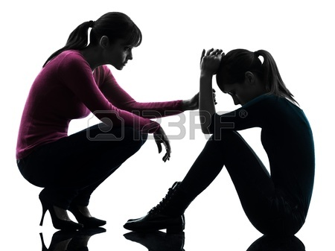
Case study
Notes:
Your experiences…

Slide 25
Small group discussion
Discuss a bereaved student/adult with whom you have worked.
Briefly describe the loss
What was your relationship to the student/adult?
Identify any special circumstances around the death.
Locate the grieving student on the Four Tasks of Grieving scale. Tell how you made this assessment.
1_____________________2_______________3_________________4
Accept reality Grief and Pain Adjust Emotionally relocate

Slide 26
Task 1 To accept the reality of the loss
Person gives details of loss by answering WHO, WHAT, WHERE, WHEN Questions
• Clients tell how they learned about death.
• Clients define the relationship they has with deceased
• Clients explain communications from family/friends, i.e., How was he informed?
• Others must understand the bereaves’ need to retell his loss story.
STRATEGIES
• Ask for pictures and ask them to tell you about them
• Discuss the differences between knowing and accepting
• Ask client to describe some reactions, e.g., search
• Explore themes of numbness, shock, unreality

Slide 27
Task #2 To work through the Pain and the Grief
Ask for pictures and ask them to tell you about them
Invite them to use art/music/movement to express their feelings
Engage them in a discussion of angry feelings towards deceased loved one and others, e.g., family, professionals, lawyers, police, hospital staff, etc.
Explore themes of fear and anxiety (Role play)
Examine and question guilt and shame- reasonable vs unreasonable (cognitive disputing)
Probe for reactive depression and look for a history of depression which might be triggered by loss (Question with care)
Explore interpersonal complications which may have been worsened by death, e.g., blame
Normalize these reactions as part of the grief process
Notes:
Clients will often tell you that they feel as though they are losing their minds because they feel as though their world is spinning out of control
Many in society are not be comfortable with another's grief. Some mourners try to distract him from the pain he feels but not permitting:
expression of painful feelings
discussion of painful thoughts or
imposing their own clichés of mourning.
•Some bereaved people: medicate themselves
immediately immerse themselves in work and travel
id themselves of all reminders of the deceased.

Slide 28
Work Though the Guilt and pain
Explore the “Big Four” affect issues with client
ANGER
GUILT
ANXIETY
SADNESS
Notes:
Anger Its sources are frustration and helplessness. It is often generalized. It can be surprising and troubling to the individual. We need to remind clients that we all have complicated and contradictory feelings about the ones we love
Guilt We often find ourselves replaying in our minds what we could have done to “prevent” another’s death. “I wasn’t all I could have been.”
Anxiety – A gut fear that we will not be able to make it on our own without the deceased. Also an awareness that we too will die someday
Sadness-Children are often uncomfortable with open expressions of feelings, especially crying. It is important to help clients experience the affect, i.e., understanding what it is like to lose someone we care for.
So much is happening on the outside that they can’t see or experience

Slide 29
Task #3 To adjust to an environment in which the deceased is missing
Coming to grips with the tasks of living without the person
Taking on skills which the deceased formerly performed.
Developing an independent sense of self, a sense of control of one's life.
Need to gain a new meaning for life.
STRATEGIES
Ask for problems they been facing-What has been the most difficult adjustment that you have had to make ?
Discuss ways that they have been solving these problems
Allow them to complain What don't people understand ?
Explore themes of abandonment.
Identify what client will miss; also what will not be missed
Monitor for self-destructive potential
Notes:
Coming to grips with the tasks of living alone, managing a home alone, raising a family by oneself.
•Taking on skills which the deceased formerly performed.
What do you need to learn to do?
•Developing an independent sense of self, a sense of control of one's life. How will you learn that ?
•Need to gain a new meaning for life. What have you learned about yourself? How did you accomplish that ?

Slide 30
Task #4 Emotionally Relocate the deceased and move on
The task is not to forget the deceased but to find a less painful place for him in one's emotional makeup.
An ability to move beyond the sticking point of grief to living effectively
Redefining one's healthy attachment to one who has died.
STRATEGIES
• Ask about the balance of good days to bad ones
• Encourage a return to old activities or new ones without guilt
• Have clients define to future without the deceased
• Explore themes of empowerment, “I have survived
• Ask for testimonials of skills developed to resolve secondary losses
• Listen for memories without pain
• Look for demonstrations of reinvestment of emotional energies in others.

Slide 31
Complicated losses
Relational Factors
Circumstantial
Historical Factors
Personality Factors
Social Factors
Notes:
Relational Factors - unexpressed hostility, ambivalence in relationships, over-identification with deceased, reminders of old wounds/self-blame, emotional “flashbacks”, unresolved dependency issues leading to helplessness and self-worth
Circumstantial Factors - body not recoverable, e.g., World Trade Center attack; war time deaths; catastrophic deaths; multiple losses experienced by one person, suicide, homicide
Historical Factors - the quality of previous losses or separations, early parental loss making a person vulnerable in present loss, the negative impact of living with ineffective, inconsistent, or domineering parent models
Personality Factors - how one’s personality structure affects one’s ability to handle emotions, the comfort level of one in expressing strong emotions or addressing negative feelings, the honesty with which one can address dependency or self-concept issues
Social Factors - loss may be viewed negatively by society, discounted as a loss in society’s eyes, or loss occurs without a social support network to help one mourn.

Slide 32
What not to do
Tell them not to cry.
Tell them they have to cry.
Tell them to get over it.
Give them a timeline.
Tell them how they feel.
Tell them how they “should” feel.
Impose your religious beliefs on the student.

Slide 33
Counseling-your favorites
Listening
Bibliotherapy
Videos
Values Clarification Activities

Slide 34
Minefields
Anniversary Dates
Significant Events
Olfactory, visual, sounds…
Others?

Slide 35
My Favorite Memories
Notes:
Task I deal with the reality

Slide 36
Notes:
Deal with the reality

Slide 37
I don’t like them because | I like these because
Changes I don’t like
Changes I like
Notes:
Deal with the reality, deal with the pain, Early adjust to the changes

Slide 38
Walking on Eggshells
When and with whom do you have to be especially careful about what you say or what you do?
How is this like walking on eggshells?
What would probably happen if you did or said the wrong thing?
How does it make you feel to have to keep being so careful around this person?
How was it different before the loss?
Notes:
Reality and pain

Slide 39
Not only did I lose you, I also lost…
Notes:
Reality, pain and ealry adjustment

Slide 40
My losses
Notes:
same

Slide 41
One more thing…
One thing I wish I had said__________________________
One thing I wish I had done_________________________
One thing I wish I had not said or done________________
________________________________________________
What I want to tell him or her is______________________
________________________________________________
_______________________________________________.
Notes:
Pain, guilt

Slide 42
Guilt
I wish I had_____________________________
If only__________________________________
Sometimes I think it is my fault that_______
_________________________________________
I want everyone to know that I am sorry that _________________________________
Sometimes it is hard to forgive_________________________________
Notes:
Guilt and pain

Slide 43
Anger and Pain
Notes:
pain
Sometimes anger management really needs to be loss management. Many of our angriest children have lost a parent or sibling to violence, drugs, alcohol, incarceration, or mental illness. Without addressing the losses, both primary and secondary (moving, foster care, grandparent care, new schools, loss of friends, possessions and privacy), the anger will not be managed. No list can take the place of appropriate grieving.

Slide 44
My Supports
Notes:
Adjust

Slide 45
Dear
I wanted to let you know how I am doing______________________________________________________
____________________________________________________________
____________________________________________________________
____________________________________________________________
____________________________________________________________
____________________________________________________________
Notes:
Adjsut/relocate

Slide 46
The gift (s)he left me…
Notes:
relocate

Slide 47
Counseling
Empty chair
Letter to . . .
Role play
Dear Abby, Oprah . . .
How I see me, how others see me
“I wish . . . “
“I miss . . . “
“It scares me most . . . “

Slide 48
Counseling
Memory activity
Identifying support people
Strength bombardment
“I used to think but now I know . . .”
Notes:
Memory activity
Plant a flower, tree
Launch a balloon
Blow bubbles
Create a collage
Write a poem, story, song
Use a tape recorder or video camera to record memories

Slide 49
Death in school community
Can compare to a death in the family
Did not have to be close friends
Loss touches off loss.
Anticipated loss-talk about it-share as much information as you can without giving too much gory detail.
Let them grieve –know it comes in cycles.
Give a purpose-make a card for the family, donate time to a cause.

Slide 50
Questions?

