Slide 1
Feelings

Slide 2
What do we know about feelings?

Slide 3
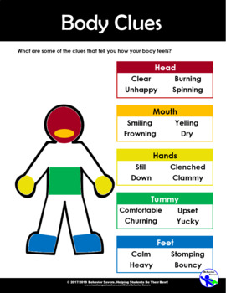
You feel feelings in your body.

Slide 4
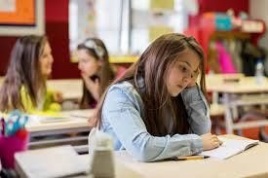
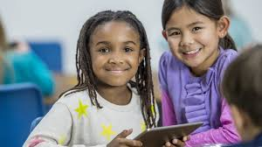
You can tell how someone else is feeling by looking at their facial expression and body language, hearing what they say, watching what they do, and looking at the situation.

Slide 5
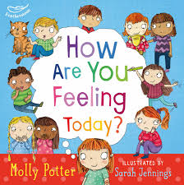
Different people can have different feelings about the same thing. This can sometimes cause conflict, but it is important to understand that not everyone will think and feel the same as you.

Slide 6
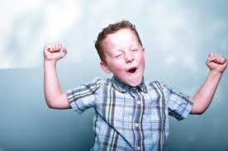
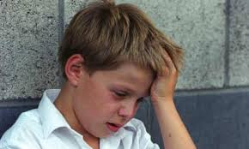
You can have two different feelings about the same situation. For example, you may be excited about moving to a new school, but worried too

Slide 7
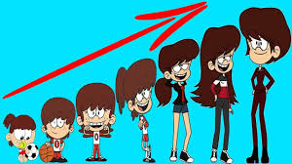
Your feelings about something can change over time. This happens because over time you gain more knowledge, understanding, experience, and maturity.

Slide 8
Let’s Play!
Read each statement and think about how that person may be feeling

Slide 9
1.
Amy’s eyes look puffy, she is quiet and looking down.
How do you think Amy is feeling?

Slide 10
1.
Natalia just received 100% on her science project. How do you think Natalia is feeling?

Slide 11
1.
James was hoping to earn MVP in the soccer game, but didn’t get it.
How do you think James is feeling?

Slide 12
1.
Jonah’s sister is having surgery in the hospital. He is not sure how the surgery will go.
How do you think Jonah is feeling?

Slide 13
1.
Corey was looking forward to eating his candybar, but his sister ate it first.
How do you think Corey is feeling?

Slide 14
ANSWERS:
Amy may have felt sad.
Natalia may have felt happy or proud.
James may have felt disappointed.
Jonah may have felt scared or worried.
Corey may have felt angry.

Slide 15
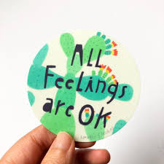
Remember…
All our feelings
are OKAY!

Slide 16
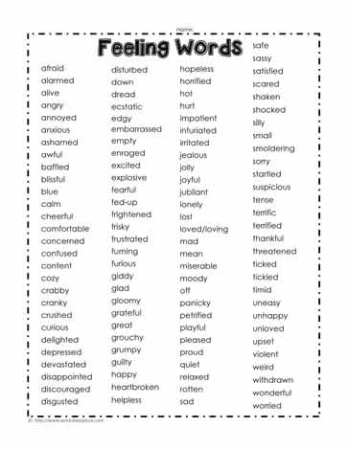
Extension Activity
Make a list of feeling words
Cut out the words and place them in a hat
Choose one and act out the feeling
Have others guess what feeling you are acting out

Slide 17
How do you feel today?
Take a picture of yourself and email it to Dr. Jones at laura.v.jones@fcps.org.
See if she can guess your feeling.

