Slide 1

Understanding Trauma

Slide 2


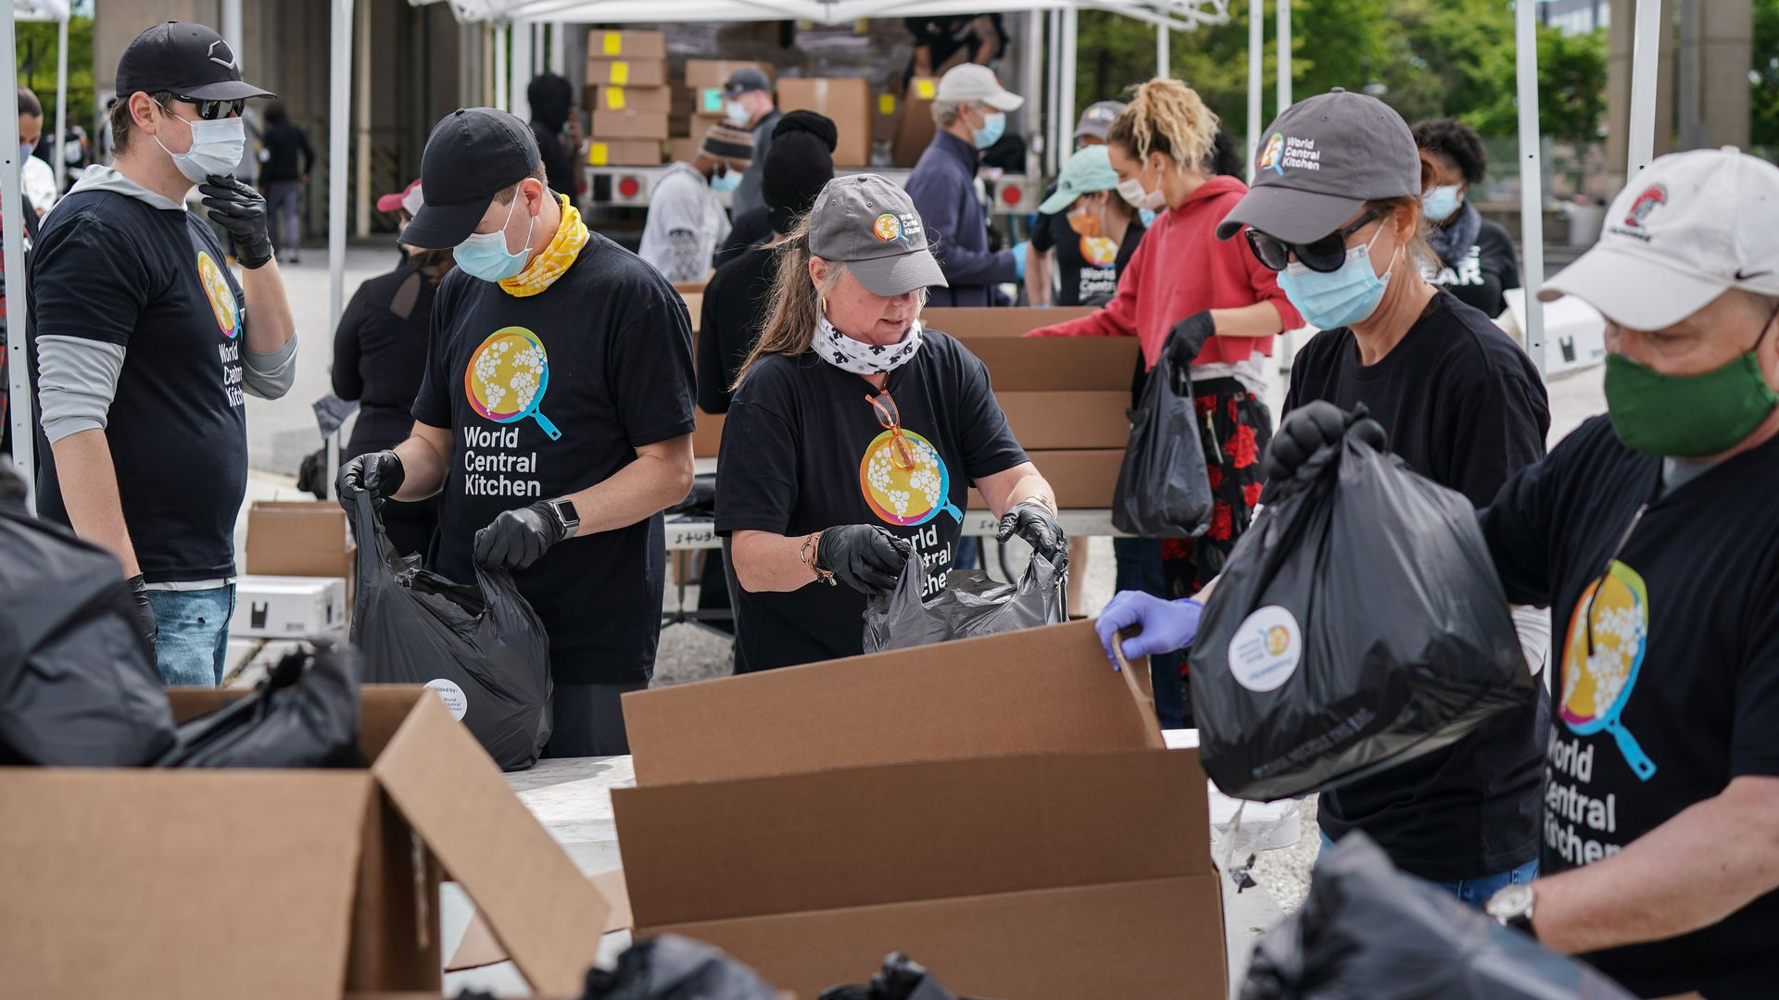
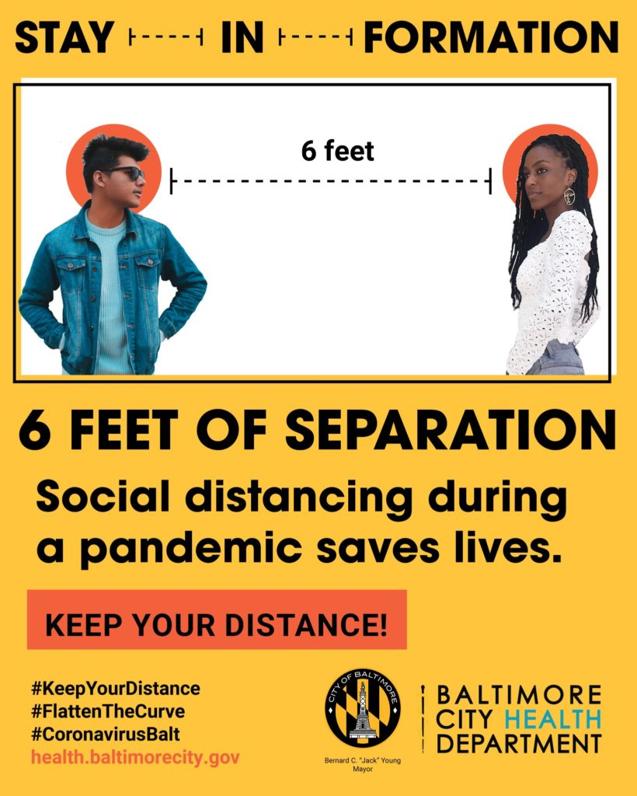
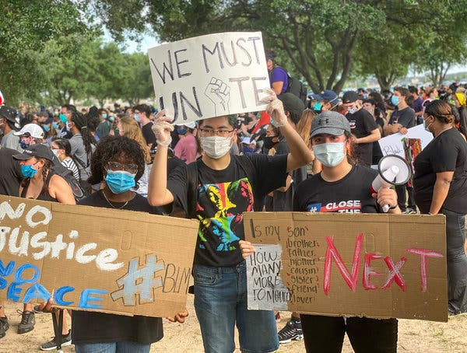







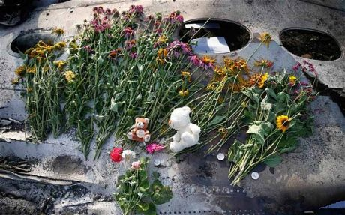
What’s Going On?
Trauma

Slide 3



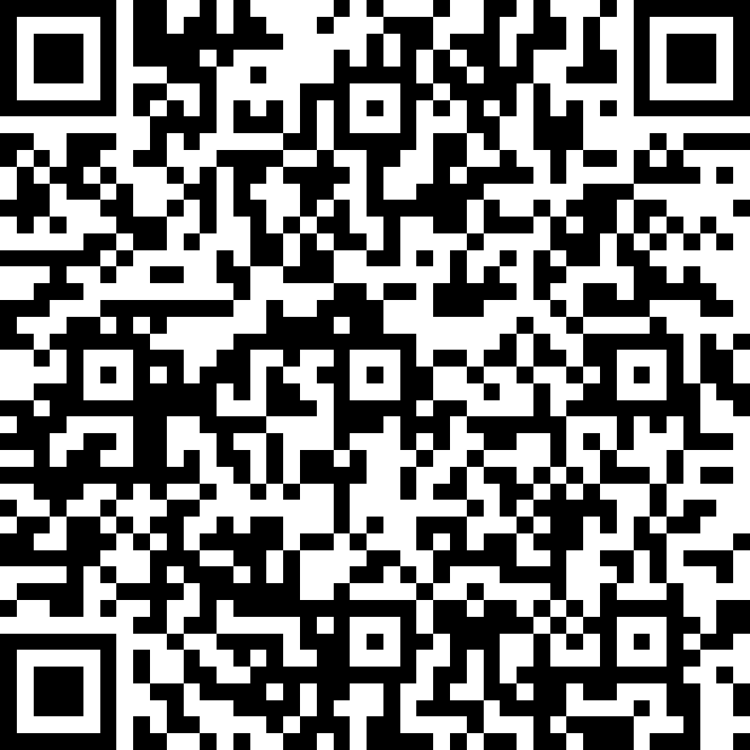
Test Your Knowledge
Please Take The Quiz – scan code with your phone and complete (picture mode)

Slide 4

Trauma
Trauma is the result of extraordinarily stressful event(s) that impacts a sense of security and may make you feel helpless.
Traumatic experiences often involve a threat to life or safety, whether real or perceived, but any situation that leaves an individual feeling overwhelmed and isolated can result in trauma, even if it doesn’t involve physical harm¹.
Can be witnessed or experienced first-hand
Can be experienced by one individual or by groups (i.e. mass shootings, natural disasters and pandemics, community violence, generational trauma)
Can be different for each person, regardless of the shared experience
Can have short-term or long-term effects

Slide 5


Who May Experience Trauma?
It should be noted, that certain groups are more at risk for experiencing trauma, including people who:
Identify as Black, Hispanic, or Multi-Racial
Report having less than a high-school education
Identify as low-income, unable to work, and/or unemployed
Identify as LGBTQ+

Slide 6



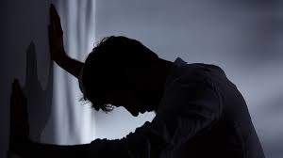





28
Is this You?
The affect trauma may have on a person

Slide 7

Please Play Video

Slide 8
Coping with Trauma

Slide 9
Coping Defined…
It should be noted, that certain groups are more at risk for experiencing trauma, including people who:
Identify as Black, Hispanic, or Multi-Racial
Report having less than a high-school education
Identify as low-income, unable to work, and/or unemployed
Identify as LGBTQ+

Slide 10

Please Play Video

Slide 11

Activity 1 – The Breathing Song Video

Slide 12

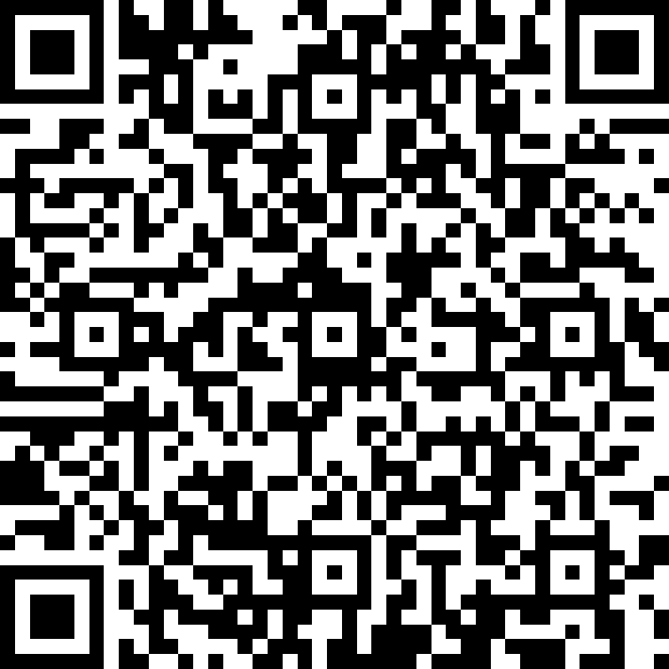
What Did You Learn?
Using your phone camera take quiz

Slide 13

Please Complete Journal Activity #2
Thoughts are Just what they are, Thoughts
Journaling is one method of helping people cope with any type of traumatic event.
Have a notebook and special pen for just journaling and gratitude
Please complete a journal entries to help with deal with your new normal after a trauma event.
Steps for Journaling.pdf

Slide 14
Together We Can Do Anything!
La Plata High School |  | McDonough High School |  | St. Charles High School |  | West Lake High School
 | Lackey High School |  | North Point High School |  | Thomas Stone High School

Slide 15
Credits
Better Health (2016, March) Trauma and Teenagers- Common Reactions. Retrieved from
https://www.betterhealth.vic.gov.au/health/healthyliving/trauma-and-teenagers-common-reactions
Mashable Deals [Deena Druck]. (2017, October 13).
How to Cope with Trauma[video]. YouTube.
https://www.youtube.com/watch?v=9urgk5HIKP4
Retrieved from https://www.helpguide.org/articles/ptsd-trauma/coping-with-emtional-and-psychological-trauma.htm.
https://www.verywellmind.com/how-to-use-journaling-to-cope-with-ptsd-2797594

