Slide 1
“Diversity may be the hardest thing for a society to live with, and perhaps the most dangerous thing for a society to live without.” William Sloane Coffin, Jr.
Presented by: [Insert name of School and Counselor]

Slide 2
Our School Counseling Team
[Insert image of school counseling team]
[Insert name, caseload and email of school counselor]
[Insert name, caseload and email of school counselor]
[Insert name, caseload and email of school counselor]

Slide 3
Objectives
By the end of the lesson, we will be able to…
Define key terms – diversity, personal lens, implicit bias, and stereotypes
Identify where we are on the road to appreciating diversity AND identify a next step for growth

Slide 4
Expectations
You are respectful
You are responsible
You are engaged

Slide 5
Check-In
Take a minute to check how you are doing physically and emotionally right now. How are you feeling today?
If you'd like to talk to someone please reach out to your counselor.

Slide 6
When we stop putting people in boxes…
https://tinyurl.com/yacncqq3
Think About It:
Have you ever been put in a box?
How did it feel?
Have you ever put someone else in a box?
How do you think they felt?

Slide 7
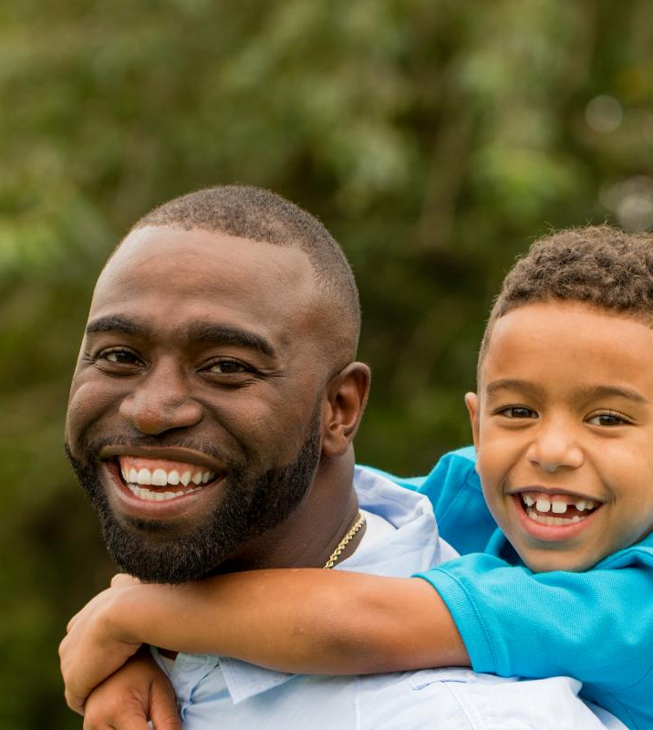
Riddle Me This…
A father and son were in a car accident where the father was killed. The ambulance brought the son to the hospital. He needed immediate surgery. In the operating room, a doctor came in and looked at the little boy and said I can't operate on him he is my son.
Who is the doctor?

Slide 8
Stereotypes
In the previous slide the doctor was also the mom. How long did it take you to realize that?
Everyone deals with or has faced stereotypes.​
Common stereotypes of certain groups are often portrayed in movies, television shows, and other types of media.​
Per your experience with these various forms of media, quickly think about the following statements…​

Slide 9
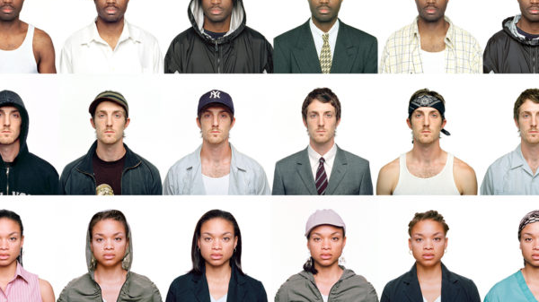
What’s the first thing that comes to your mind?
All lawyers are…
All construction workers are…
All black people are…
All white people are…
All young people are…
All old people are...
All high school students are...

Slide 10
Stereotypes
Where do these stereotypes come from
From what and whom do we learn/are exposed to these views?
What prejudices result from these stereotypes?
What harm can come from these stereotypical views?
At school?
Beyond school?

Slide 11
Implicit Bias
The attitudes or stereotypes that affect our understanding, actions, and decisions in an unconscious manner
These are unconscious and learned
Everyone has implicit bias
This does NOT mean that someone is racist or has racist tendencies
We all need to be aware of our implicit bias and check our attitudes and behavior

Slide 12
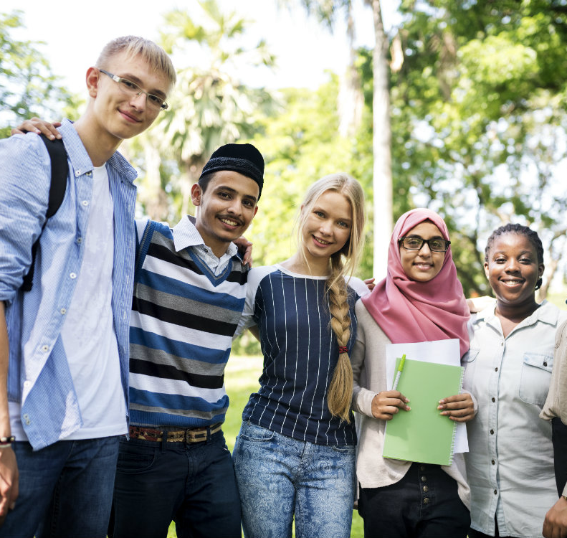
Food For Thought:
How do you explore and encounter differences in others?
Have you ever had a wrong first impression of someone who had a different background or came from another culture?
What might be some barriers that prevent people from valuing diversity?
How would you build connections with someone regardless of similarities or differences?
What does it mean to put yourself in someone else’s shoes?

Slide 13
What is diversity?
“Any dimension that can be used to differentiate groups and people from one another.”
Includes all of the human characteristics that make us unique and valuable as individuals
Includes everyone and excludes no one

Slide 14
What are some of the things you think of when you hear “diversity”?
Sexual Orientation
Socio-economic Status
Sex/ Gender
Ability/ Disability
Family Structure
Religion
Diversity
Race/ Ethnicity
Etc. Etc. Etc.

Slide 15
What does diversity mean?
The concept of diversity encompasses acceptance and respect.
It means understanding that each individual is unique, and recognizing our individual differences.

Slide 16
Personal Lens
All the things that make up who we are and how we view situations can be referred to as our personal lens.
Our lens is made up of values we hold, our culture and background, and our life experiences.
Life experiences include things that we choose to do, as well as things we do not have any choice about or control over.

Slide 17
Why is diversity important?
“By talking and listening to people different from ourselves, we learn and enlarge our understanding.”
Promotes growth and reflection
Career preparation
Preparation for life outside of school

Slide 18
The road to appreciating diversity
Knowledge
Tolerance
Reflection
Integration
Appreciation

Slide 19
The road to appreciating diversity
Appreciating Diversity is a process
Understand and recognize barriers along journey:
Stereotypes
Biases/Prejudices
Discrimination
Racism, and other “isms”
age, disabilities, athletic ability, weight
Ignorance/Lack of Awareness

Slide 20
The road to appreciating diversity
Some will say:
I didn’t realize that was offensive.
I didn’t know that was a derogatory statement.
How was I supposed to know?
It is a process, a journey… but when we know better, we must do better
We all learn more as we travel towards appreciating diversity

Slide 21
Exploring Words and Feelings
What does Tolerance sound like? What do people say when they are tolerating a person that is different than them?
How do you think you would feel if someone was tolerating your differences?
What does Acceptance sound like? What types of words do people use to show that they accept a person that is different than them?
Think about a time when someone has shown you acceptance. How did it make you feel?
What does Celebration sound like? What are some words and phrases that people use when they are celebrating a person that is different than them?
How would you feel if you the people around you were celebrating your diversity?

Slide 22
Language of Celebration
What would you say to celebrate someone else’s diversity?
Try using any of the words on the right in a celebratory sentence.

Slide 23
Exit Ticket
Directions: Pick one unique characteristic/quality about yourself that is important to you and that you want your classmates to know. Add it to the word-cloud at this link:
[Insert Link to your Answer Garden >https://answergarden.ch/]

Slide 24
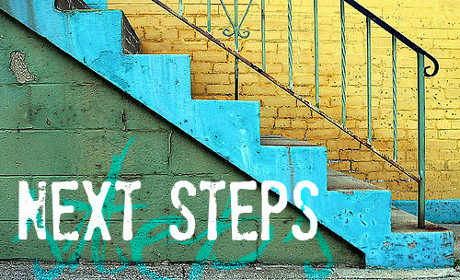
What’s Next?
Challenge to branch out, move beyond personal comfort zone.
Be an upstander – as simple as asking a question:
When you hear someone make a derogatory statement or insensitive joke
Try something new
Look beyond the first 6 seconds
Give people a chance…you never know what role you will play in someone's life
ASK: Why did you say that?
ASK: What makes you feel that way?
ASK: Did you know that is offensive?

Slide 25
Reminder:
If you need to talk, reach out to a school counselor
[Insert names and emails of counselors]

Slide 26
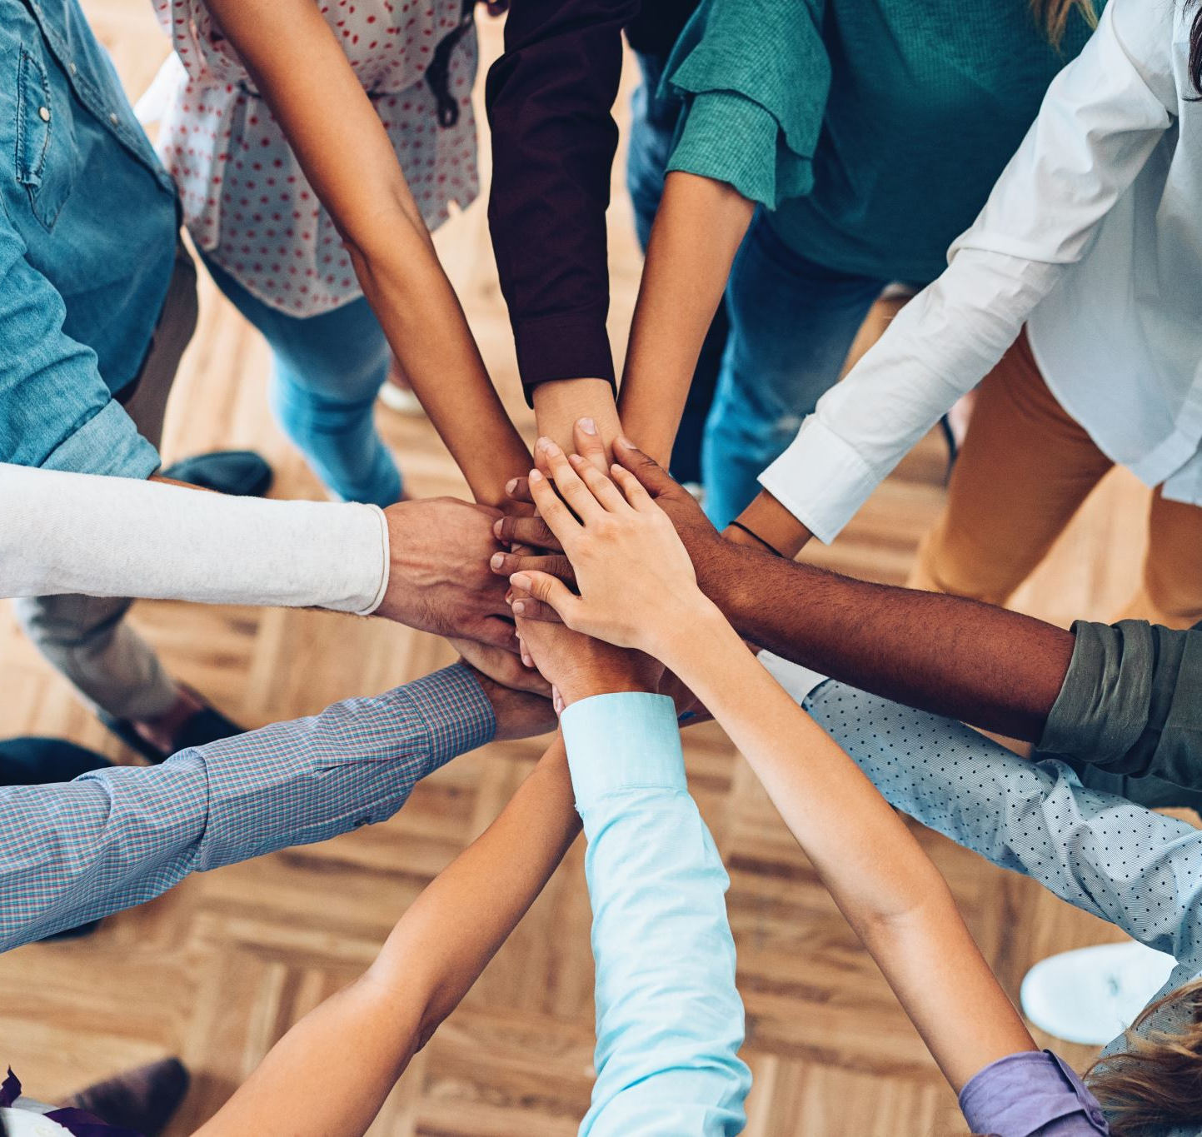
Resources
Anti-Racism Resources for White People
Anti-Racism Resources for Teens
Anti-Racist Reads

